Slide 1
Wirepool
PIP104 PROFESSIONAL PRACTICE-II
VIVA-VOCE
Batch Number: CSE-G04
Roll Number | Student Name
20201CSE0002 | Kunal Rana
20201CSE0010 | Yash Choudhary
20201CSE0029 | Manshi Maurya
20201CSE0057 | Aryan Kaushik
20211LCS0001 | Eshana Chauhan
Under the Supervision of,
Dr. Pamela Vinitha Eric
Professor
School of Computer Science Engineering & Information Science
Presidency University

Slide 2

Introduction
Wirepool, an innovative service-based application tailored to address the challenges encountered in service evaluation and management. Wirepool is designed to streamline service duration estimation and pricing mechanisms, catering to the dynamic needs of users.
It allows customers to explore a wide array of products, compare prices effortlessly, and make informed decisions. Embracing technology in commerce not only facilitates smoother transactions but also enhances the overall shopping experience for both consumers and sellers. It's crucial for businesses to adapt to the evolving landscape to better cater to the dynamic needs of the market.

Slide 3
Literature Review
Application using MERN Stack - Dr. Santosh Kumar Shukla, Shivam Dubey,
Tarun Rastogi, Nikita Srivastava (2002)
The service supply-demand matching method and system aim to create a real-time platform connecting demanders and suppliers, facilitating the matching of demand and supply services.
This involves extracting and matching keywords, sending demand applications to matched suppliers, and providing remuneration.
The system fosters cooperation by sharing contact information and collecting remuneration upon completion.
The overarching goal is to empower the demand side with supply solutions and offer the supply side increased partnerships and employment opportunities.

Slide 4
Service supply and demand matching method and system - Qui Chong (2019)
The method involves the extraction and matching of keywords from demand services, ensuring successful transmission of demand applications to matched suppliers, streamlining the process.
The system emphasizes building a cooperation relationship between demanders and suppliers. It achieves this by sharing contact information and collecting remuneration upon the successful completion of the cooperation.
The overall objective is to empower the demand side by providing effective solutions from the supply side, enhancing the efficiency of service supply-demand dynamics.
The system aims to benefit the supply side by offering more partners and employment opportunities, contributing to a mutually beneficial ecosystem in the service industry.

Slide 5
Research Gaps Identified
Compatibility Issues:
Lack of uniformity across different platforms leads to challenges in compatibility and consistent user experience.
Existing hybrid mobile application frameworks may fail to provide a seamless user experience across various platforms.
Technical Limitations:
Development complexities arise when targeting multiple native platforms simultaneously.
Technical optimizations may pose challenges, leading to time and cost constraints in application development.
Acceptance and Adoption:
Resistance to the adoption of new mobile services among users and stakeholders.
Challenges related to the acceptance and adoption of mobile apps in specific industries, hindering their full potential utilization.
Regulatory and Compliance Challenges:
Adherence to industry-specific regulations and compliance standards in healthcare applications might present challenges during development and deployment.
Ensuring alignment with privacy laws and regulatory frameworks for healthcare data handling and storage.
Technical Limitations in Mobile App Security:
Continuous evolution of threats and vulnerabilities necessitates ongoing updates and security patches, posing challenges for maintaining robust security measures. Limitations in effectively addressing sophisticated cybersecurity threats targeting mobile applications.

Slide 6
Proposed Methodology
1. User-Centric Design:
Develop an intuitive and user-friendly interface for the mobile app to ensure accessibility and ease of use.
Prioritize user experience by incorporating feedback and insights from end users throughout the design process.
2. Diverse Service Integration:
Collaborate with Original Equipment Manufacturers (OEMs), Process Specialists, Electricians, and Freelance Consultants to onboard a diverse pool of skilled professionals.
Implement a systematic process for verifying and validating the credentials and expertise of the service providers.
3. Real-Time Communication Features:
Integrate real-time communication features within the app to facilitate seamless interactions between end users and service providers.
Implement instant messaging, video calls, and other communication tools to enhance collaboration and problem-solving.
4. Streamlined Service Requests:
Develop a streamlined system for end users to submit service requests, specifying their requirements and preferences.
Implement algorithms to efficiently match service requests with the most suitable professionals based on expertise, location, and availability.
5. Robust Authentication and Security:
Prioritize the security of user data and transactions by implementing robust authentication measures.
Utilize encryption protocols to safeguard sensitive information and ensure a secure environment for both end users and service providers.

Slide 7
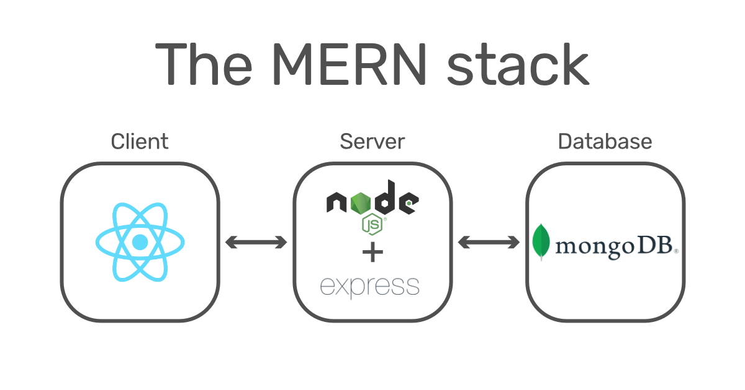
Objectives
Enhance Service Accessibility:
Provide a centralized hub where end users can easily discover, explore, and access a wide range of services tailored to their specific needs.
Promote Real-Time Communication:
Foster effective communication channels within the application, enabling seamless interactions between end users and service providers for better collaboration and understanding.
Integrate Payment Solutions:
Facilitate secure and convenient transactions by integrating reliable payment gateways, ensuring a smooth and trustworthy payment process for both end users and service providers.
Ensure Scalability and Performance:
Develop a scalable architecture that can accommodate the growth of users and services over time while maintaining high performance and responsiveness.

Slide 8
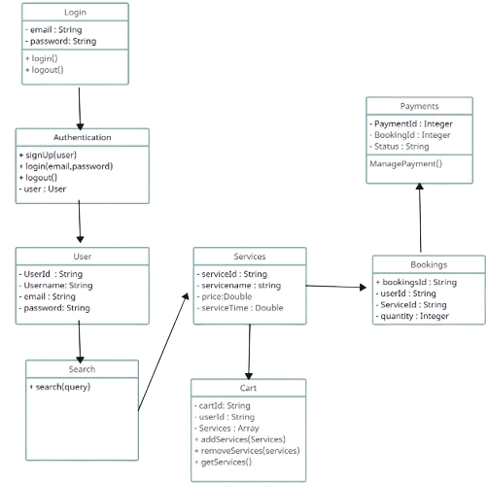
System Design & Implementation
Class Diagram :
Creating a class diagram for an e-commerce MERN
(MongoDB, Express.js, React.js, Node.js)
project involves identifying the key classes and their relationships.
Below is a simplified representation of the
class diagram for the specified features:
login/signup, home, search, bookings, and cart pages.

Slide 9
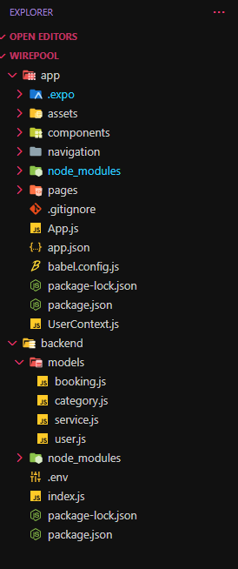
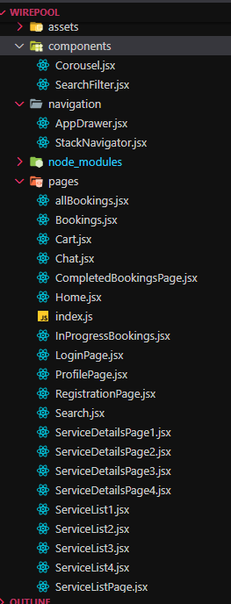
FrontEnd
Folders
Pages of wirepool

Slide 10
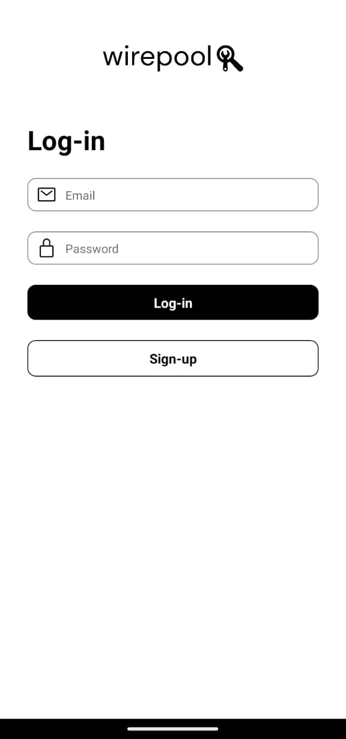
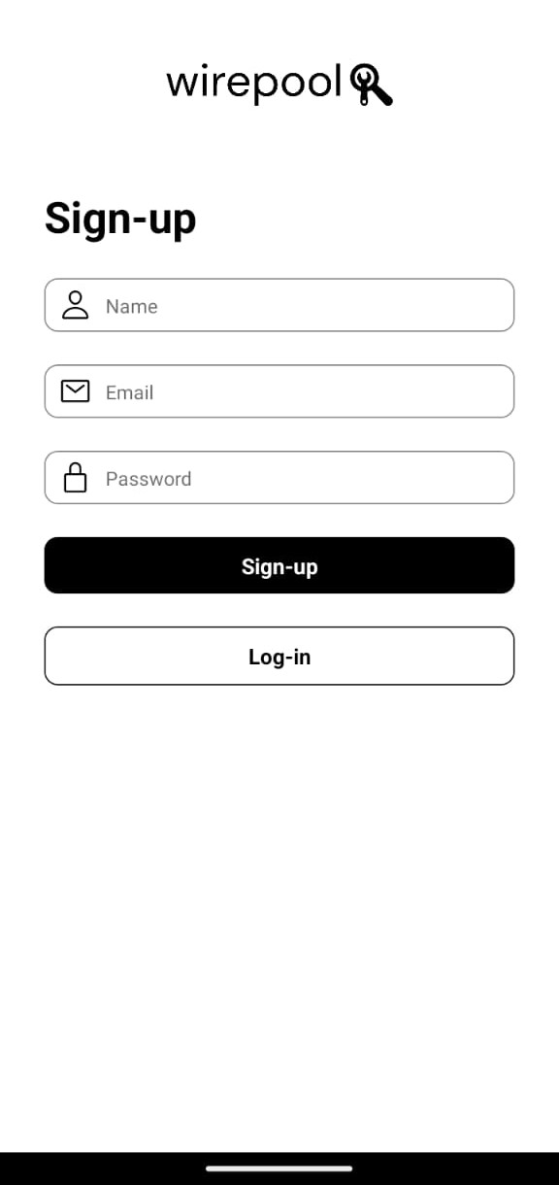
Login / Register page :
This page serves as the entry point for users to access your app.
New users can register for an account, providing necessary details, while returning users can log in.
It's a crucial component for user authentication and access to personalized features.

Slide 11
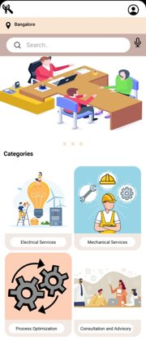
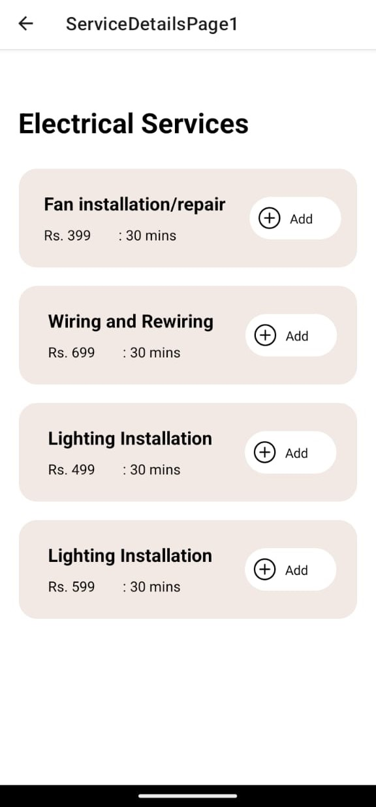
Home page & Service List Page
The home page is the main screen users see upon logging in. It provides a personalized and dynamic view, showcasing relevant content, recommendations, or featured items. The goal is to engage users and encourage exploration of the app's offerings.
Header:
- Name of the Category
- Breadcrumbs for navigation.
Service Listings:
- List view with names, prices, and timings
- Quick "Add to Cart" buttons.

Slide 12
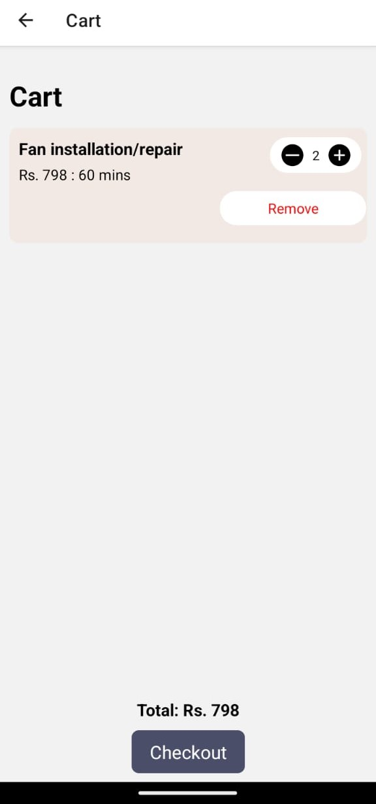
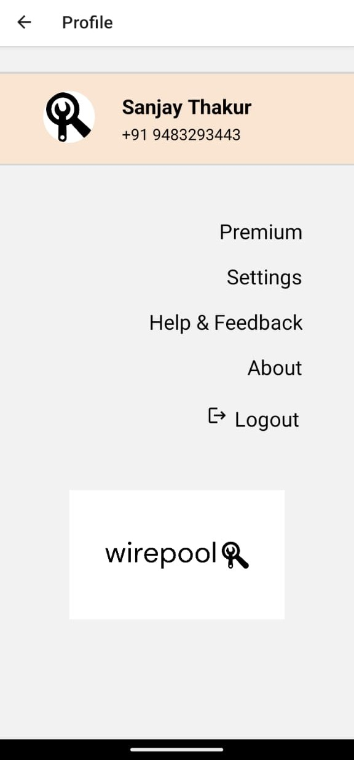
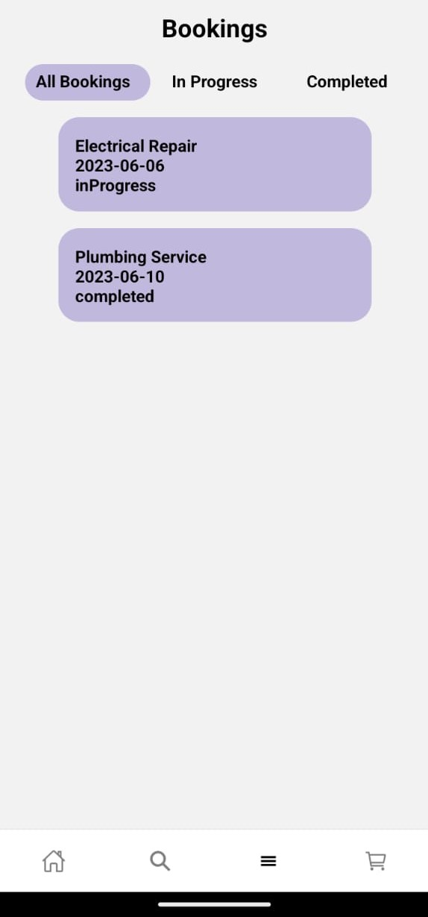
Cart page :
The cart page displays the items users have added to their shopping cart or booking list.
Users can review, modify, or proceed to checkout/book directly from this page.
It's a crucial step in the e-commerce or booking process, providing a clear overview of selected items.
Bookings page :
The bookings page is relevant for apps that involves scheduled events.
Users can view, modify, or cancel their existing bookings.
This page helps users manage their commitments within the app and provides a seamless booking experience.

Slide 13
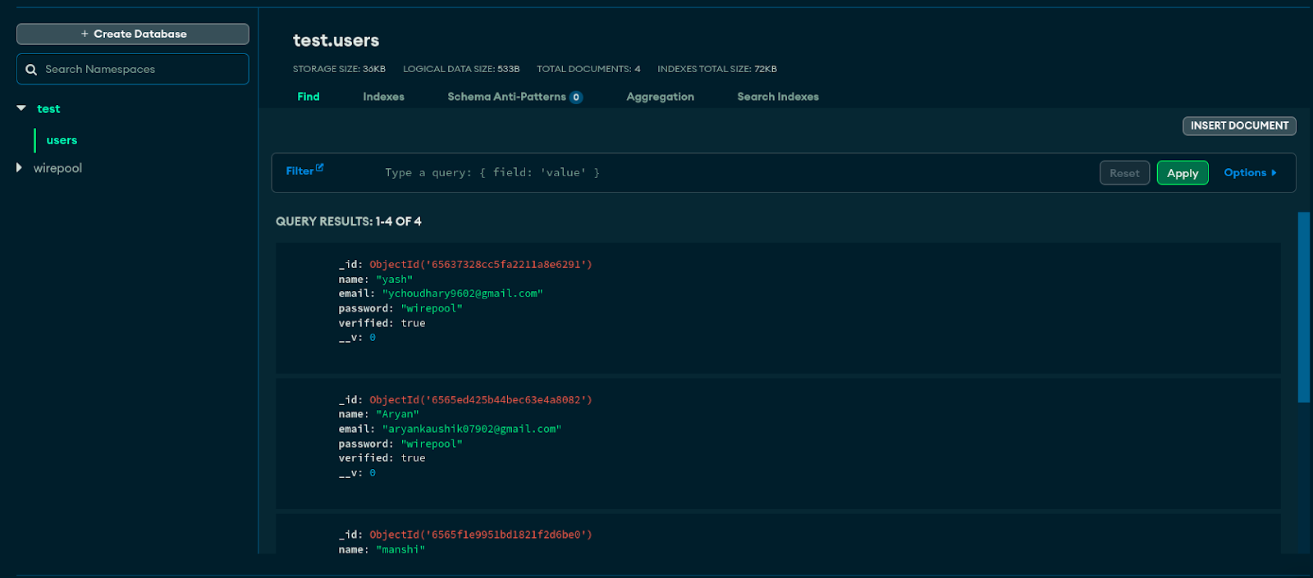
Backend
MongoDB Atlas

Slide 14
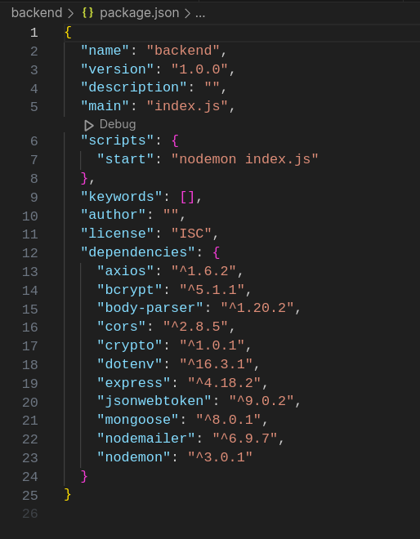
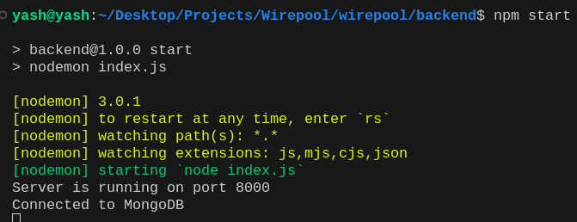
Backend
Backend connected and running
Packages Used

Slide 15
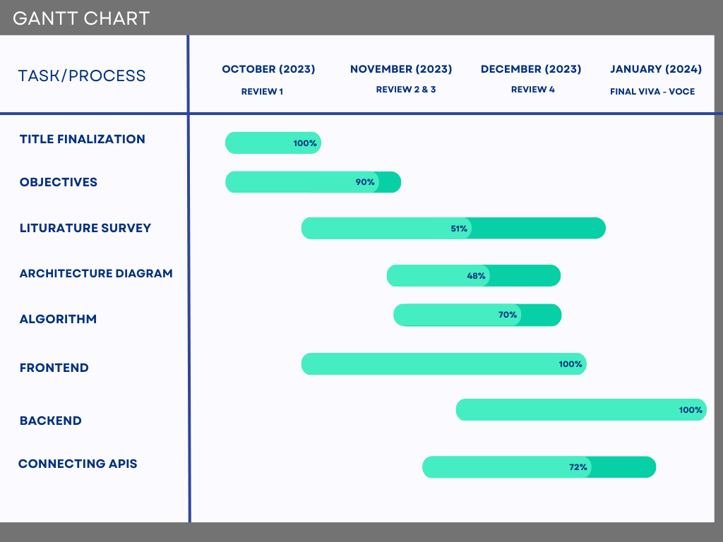
Timeline of Project

Slide 16
Outcomes / Results Obtained
UI/UX Design:
Intuitive design for easy navigation.
Positive beta test feedback on user-friendly interface.
Streamlined service request processes enhance satisfaction.
Authentication and Security:
Robust authentication ensures data and transaction security.
Encryption protocols and secure login methods for trust.
Continuous monitoring and updates address emerging security concerns.
Service Request Management:
Efficient platform for submitting and tracking requests.
Real-time updates and notifications enhance transparency.
Integrated feedback mechanisms for continuous improvement.

Slide 17
Collaboration and Communication:
Wirepool fosters seamless communication between users and professionals.
Features like instant messaging and video conferencing aid effective collaboration.
Positive feedback on bridging the gap between users and professionals.
Diverse Service Offerings:
Accommodates diverse services, connecting with OEMs, Process Specialists, Electricians, and Freelance Consultants.
Versatile platform attracts a wide range of users seeking different expertise.
Future Vision and Ecosystem Impact:
Wirepool's vision harmonizes expertise and demand.
Potential to revolutionize service delivery, creating a thriving ecosystem.
Ongoing improvements planned to adapt to evolving industry needs.

Slide 18
Conclusion
The journey of conceptualizing, developing, and deploying Wirepool has been both challenging and rewarding, culminating in a platform that bridges the gap between users and specialized professionals in an unprecedented manner. This project, built on the MERN stack, signifies the power of innovative technology solutions in addressing real-world challenges and enhancing user experiences. make it simple and optimized. closes the gap between users and experts like never before. It shows how tech can tackle real issues and boost user experiences.

Slide 19
References
^{[1]}E-commerce Definition – What is E-commerce? [Internet]. Shopify.com. Available from: https://www.shopify.com/encyclopedia/what-is-ecommerce
^{[2]}Advantages of E-commerce [Internet]. Thebalancesmb.com 2019 [cited 20 November 2019]. Available from: https://www.thebalancesmb.com/ecommercepros-and-cons-1141609
^{[3]}Dr. Santosh Kumar Shukla, Shivam Dubey, Tarun Rastogi and Nikita Srivastava. Application using MERN Stack. International Journal for Modern Trends in Science and Technology 2022, 8(06), pp. 102-105.
https://doi.org/10.46501/IJMTST0806014
^{[4]}Vipul Kaushik, Kamali Gupta, Deepali Gupta - React Native Application Development
https://papers.ssrn.com/sol3/papers.cfm?abstract_id=3330011
^{5]}Qui Chong - Service supply and demand matching method and system
^{[6]}Buddhini Gayathri Jayatilleke, Gaya R. Ranawaka, Chamali Wijesekera and Malinda C.B. Kumarasinha - Development of mobile application through design-based research
https://www.researchgate.net/publication/327663611_Development_of_mobile_application_through_design-based_research

Slide 20

Thank You

